Slide 1
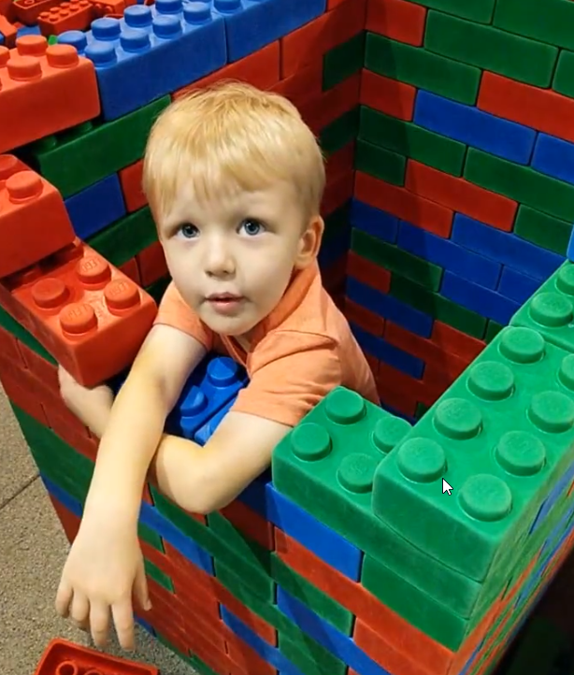
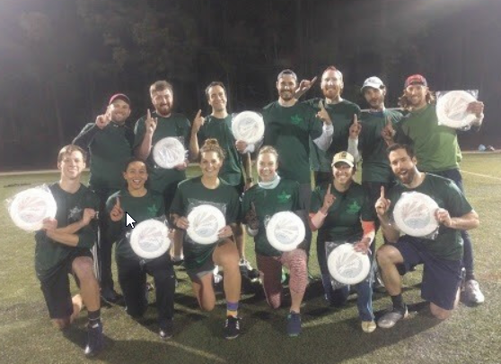
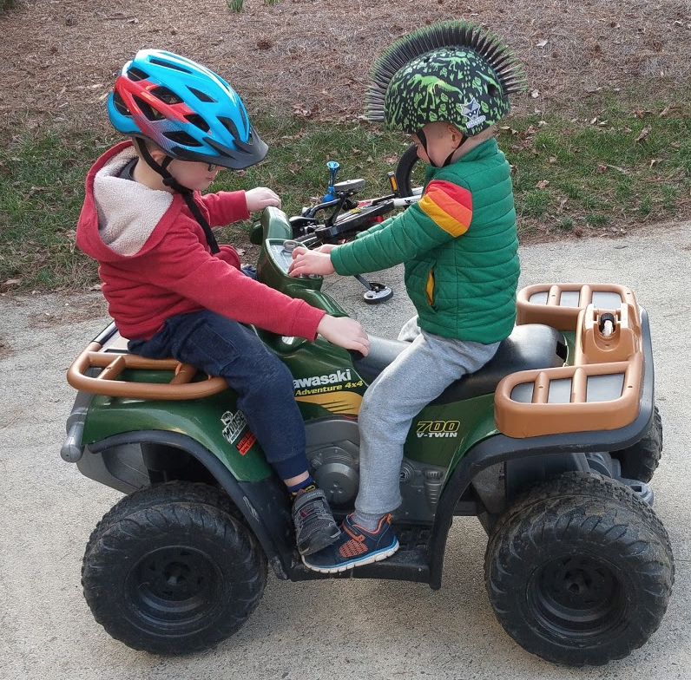
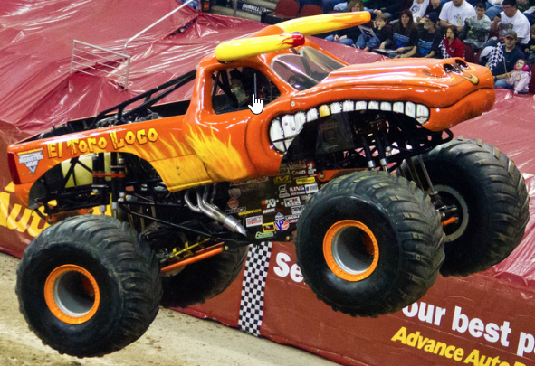
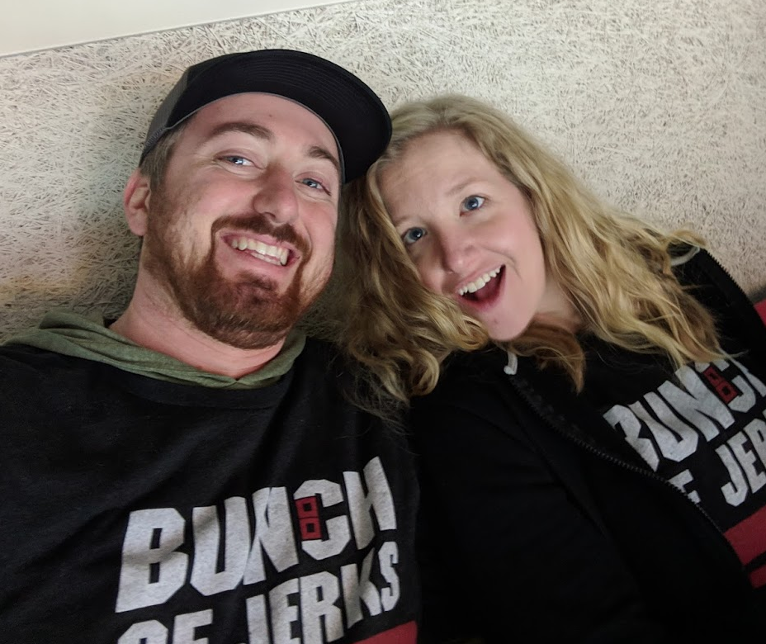
Who am I?
Jeff Nowiski
Database Engineer at Citrix
Interests
PowerShell because I am lazy
tSQL tuning because I like to make things better
Carolina Hurricanes fan because I’m a jerk
Monster truck fan because I have 2 boys (go El Toro Loco)
PowerWheels because I still act like a child
Jackalope because they are real
Jillalopes because they might be real
Legos because they make parenting easier
Ultimate Frisbee because the sweet hucks
Puns because they are the highest form of humor

